Slide 1



Heart Disease Prediction
Vaishnavi Sahu 2024011004000206
Priya Chauhan 202401100400148
Shreya Maurya 202401100400181
Urvi Gupta 202401100400201

Slide 2



Problem Statement
Develop a classification model to detect heart disease based on medical parameters. Visualize data and model predictions.

Slide 3



Introduction
Heart disease is one of the leading causes of mortality globally, accounting for millions of deaths each year. Early detection and diagnosis are critical in reducing fatality rates and ensuring effective treatment. With the advancement of machine learning (ML) and data analysis, we can now build intelligent systems that assist in predicting heart disease based on medical parameters.

Slide 4

Methodology
The dataset used in this project was initially uploaded in ZIP format. Using Python, the ZIP file was extracted, and the CSV file containing the heart disease data was loaded into a pandas DataFrame for analysis. After loading the data, preprocessing steps were applied to ensure it was clean and suitable for modeling. Columns such as 'id' and 'dataset', if present, were dropped to remove irrelevant information. The target column 'num' was converted into a binary format, where 0 indicated no heart disease and 1 indicated the presence of heart disease.
To handle missing values, categorical columns were filled with their mode (most frequent value), while numerical columns were filled with the median to maintain data consistency. All categorical features were then encoded into numerical form using Label Encoding. A correlation heatmap was plotted using Seaborn to visualize the relationships between numeric features and to identify significant indicators associated with heart disease.
The cleaned dataset was then split into training and testing subsets using an 80:20 ratio with the help of train_test_split. Standardization of features was performed using StandardScaler to bring all variables to_{Y}a similar scale, which enhances model training and prediction accuracy.

Slide 5
Code
# 💡 Heart Disease Prediction using Random Forest
# ✅ Step 1: Import Required Libraries import pandas as pd
import numpy as np
import matplotlib.pyplot as plt import seaborn as sns
from sklearn.model_selection import train_test_split from sklearn.preprocessing import StandardScaler from sklearn.ensemble import RandomForestClassifier
from sklearn.metrics import accuracy_score, confusion_matrix, classification_report
import zipfile import io
from google.colab import files import os
# ✅ Step 2: Upload ZIP File
print("🔼 Please upload the ZIP file containing your CSV dataset...") uploaded = files.upload()
# ✅ Step 3: Extract ZIP and Find CSV csv_path = None
for fname in uploaded.keys(): if fname.endswith('.zip'):
with zipfile.ZipFile(io.BytesIO(uploaded[fname]), 'r') as zip_ref: zip_ref.extractall("/content/heart_data")
print("✅ Extracted Files:", zip_ref.namelist()) for file in zip_ref.namelist():
if file.endswith('.csv'):
csv_path = os.path.join("/content/heart_data", file)

Slide 6
# ✅ Step 4: Load CSV into DataFrame if csv_path:
df = pd.read_csv(csv_path)
print("✅ CSV Loaded Successfully!\n") else:
raise Exception("❌ No CSV found inside the ZIP!")
# ✅ Step 5: Dataset Preview and Null Check print("\n📌 Dataset Preview:") print(df.head())
print("\nQ Null Values:") print(df.isnull().sum())
# ✅ Step 6: Encode Non-Numeric Columns (if any) non_numeric_cols = df.select_dtypes(include=['object']).columns if len(non_numeric_cols) > 0:
print(f"\n🔧 Encoding non-numeric columns: {list(non_numeric_cols)}") df = pd.get_dummies(df, drop_first=True)
else:
print("\n✅ No non-numeric columns found.")
# ✅ Step 7: Detect Target Column AFTER Encoding binary_targets = [col for col in df.columns if df[col].nunique() == 2] if len(binary_targets) == 0:
raise Exception("❌ No binary target column found!") elif len(binary_targets) == 1:
target_col = binary_targets[0]
print(f"\n🎯 Target column detected: '{target_col}'") else:
print(f"\n🧠 Multiple binary columns found. Defaulting to: '{binary_targets[0]}'") print("Others:", binary_targets)
target_col = binary_targets[0]

Slide 7
# ✅ Step 8: Correlation Heatmap plt.figure(figsize=(12, 10))
sns.heatmap(df.corr(), annot=True, cmap='coolwarm') plt.title("📊 Correlation Heatmap")
plt.show()
# ✅ Step 9: Split Dataset
X = df.drop(target_col, axis=1) y = df[target_col]
X_train, X_test, y_train, random_state=42)
y_test = train_test_split(X, y, test_size=0.2,
# ✅ Step 10: Feature Scaling scaler = StandardScaler()
X_train = scaler.fit_transform(X_train) X_test = scaler.transform(X_test)
# ✅ Step 11: Train Random Forest Model
model = RandomForestClassifier(n_estimators=100, random_state=42) model.fit(X_train, y_train)
y_pred = model.predict(X_test)
# ✅ Step 12: Accuracy and Classification Report accuracy = accuracy_score(y_test, y_pred) print(f"\n✅ Model Accuracy: {accuracy:.4f}")
print("\n📋 Classification Report:\n", classification_report(y_test, y_pred))
# ✅ Step 13: Confusion Matrix plt.figure(figsize=(6, 5))
sns.heatmap(confusion_matrix(y_test, y_pred), annot=True, fmt='d', cmap='Blues') plt.title("Q Confusion Matrix")
plt.xlabel("Predicted") plt.ylabel("Actual")

Slide 8
# ✅ Step 14: Feature Importances feature_imp = pd.DataFrame({
'Feature': X.columns,
'Importance': model.feature_importances_
}).sort_values(by='Importance', ascending=False)
plt.figure(figsize=(10, 6))
sns.barplot(x='Importance', y='Feature', data=feature_imp) plt.title("📈 Feature Importances")
plt.tight_layout() plt.show()
# ✅ Step 15: Actual vs Predicted Plot plt.figure(figsize=(8, 5))
sns.histplot(y_test, color='green', label='Actual', kde=True) sns.histplot(y_pred, color='red', label='Predicted', kde=True)
plt.title("📉 Actual vs Predicted Distribution") plt.legend()
plt.show()
# ✅ Step 16: Print Predictions (Optional) print("\n🔮 First 20 Predictions:") print("Actual:", y_test.values[:20]) print("Predicted:", y_pred[:20])

Slide 9
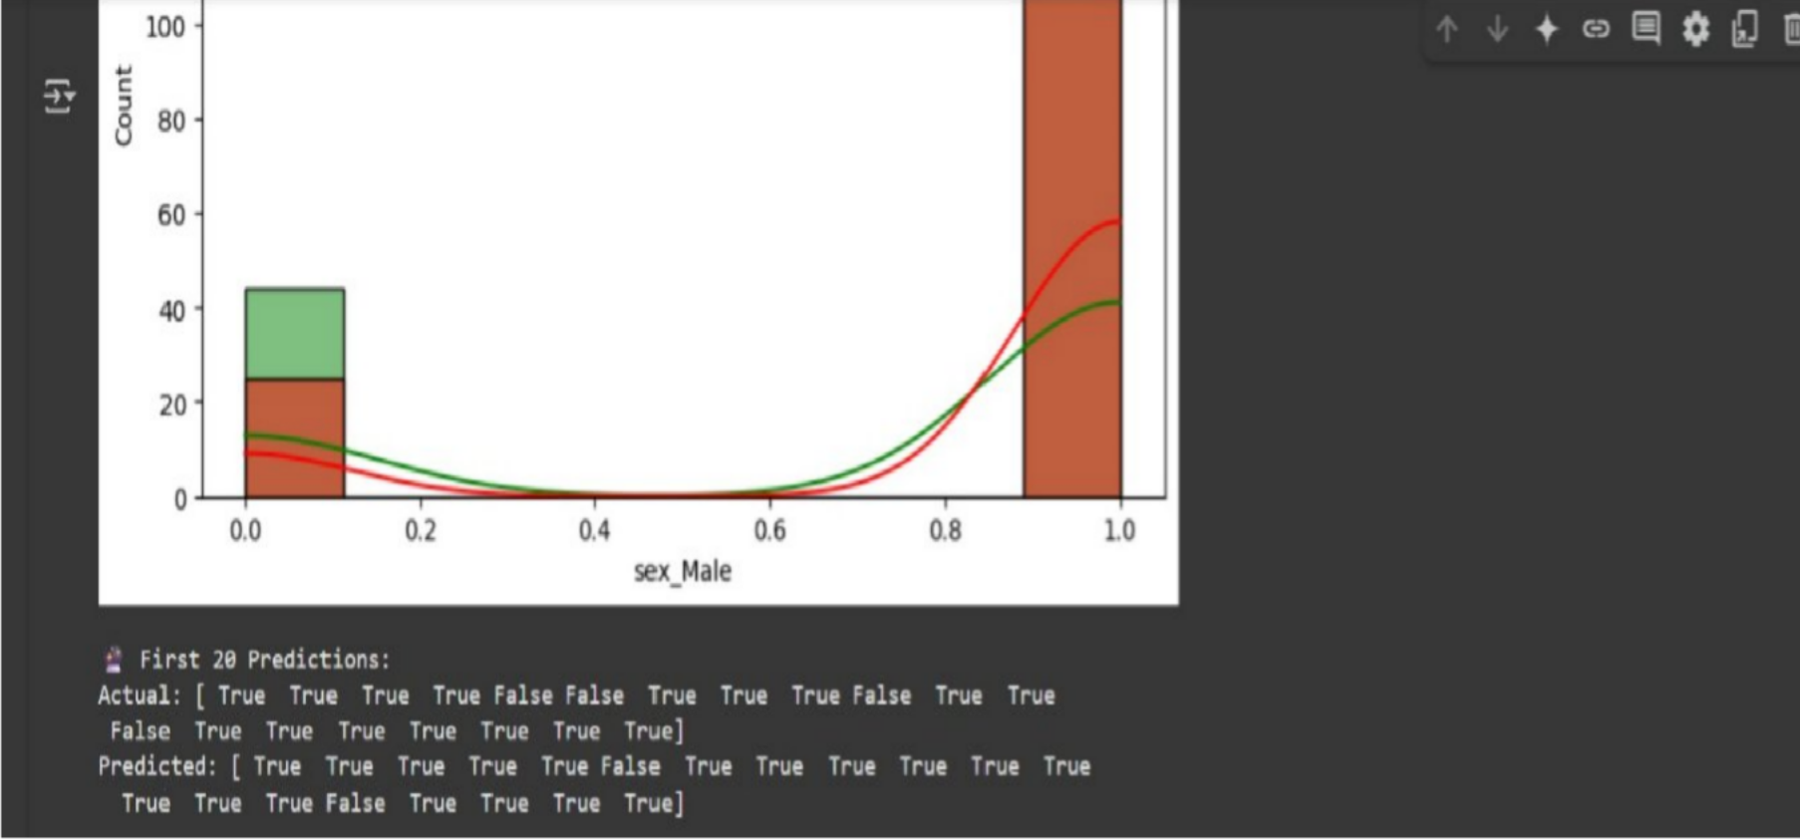
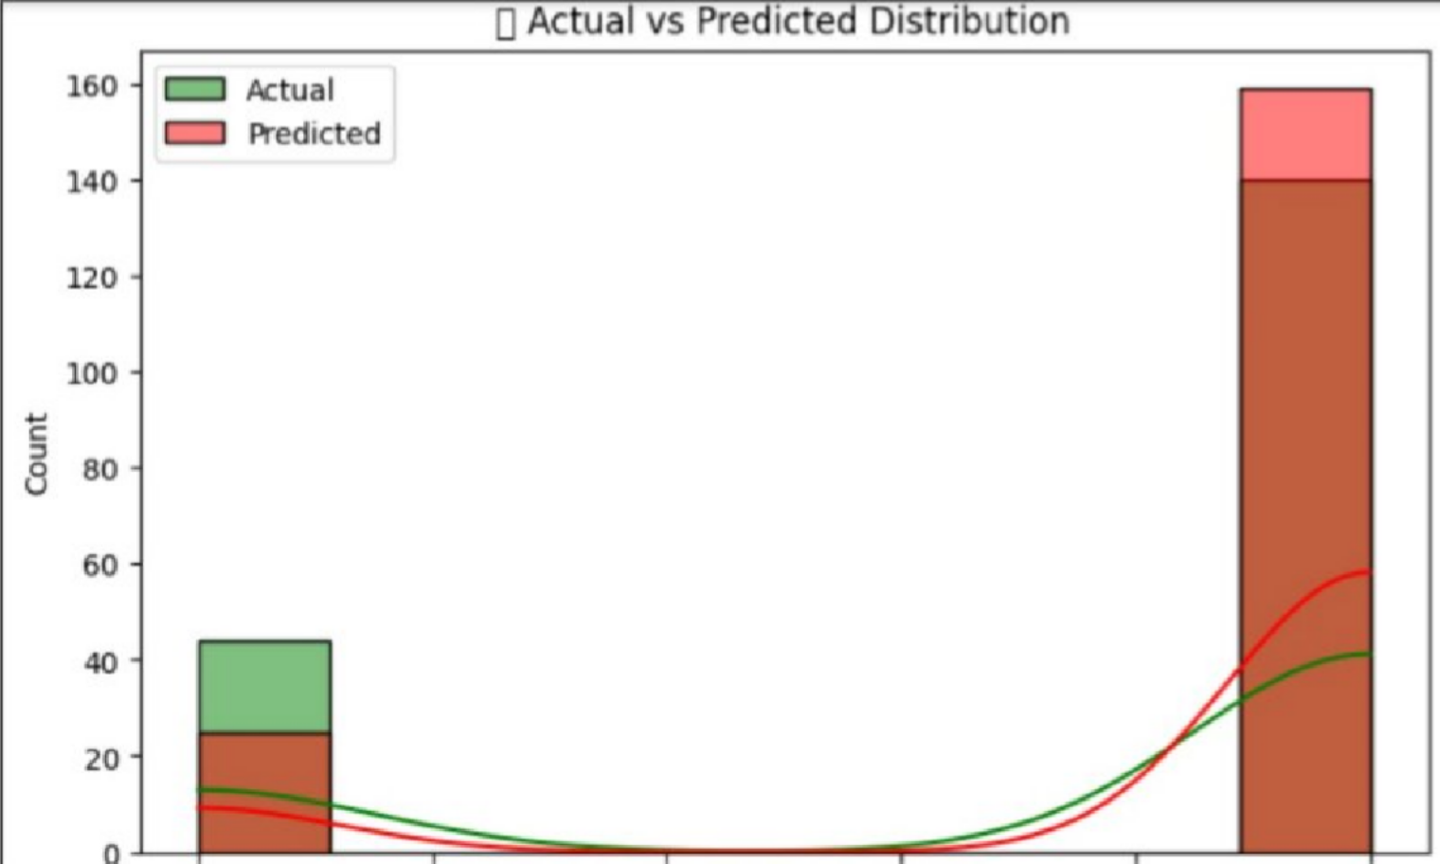
Output/Result

Slide 10
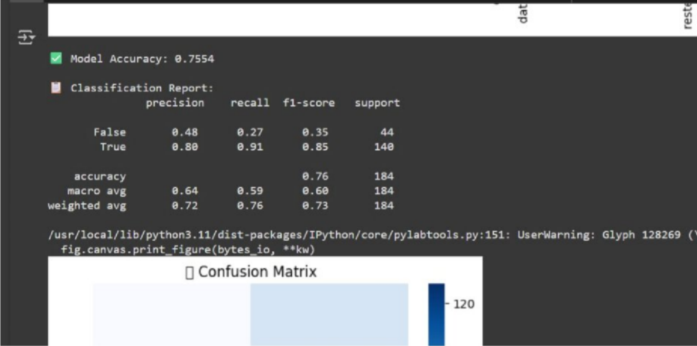
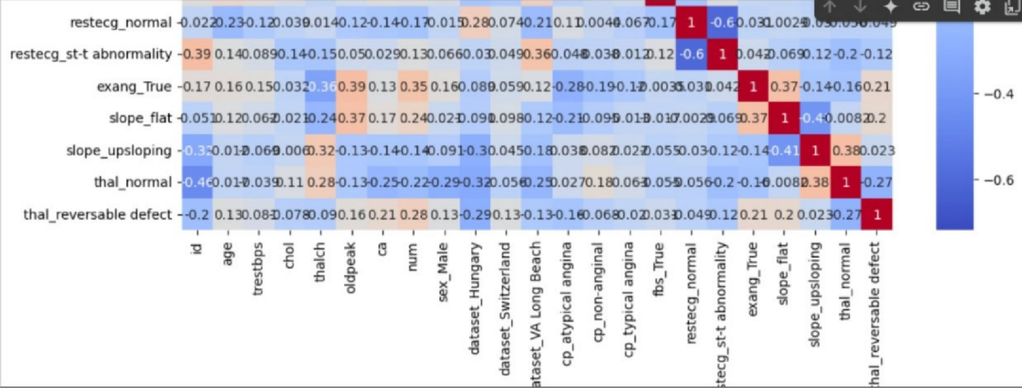

Slide 11
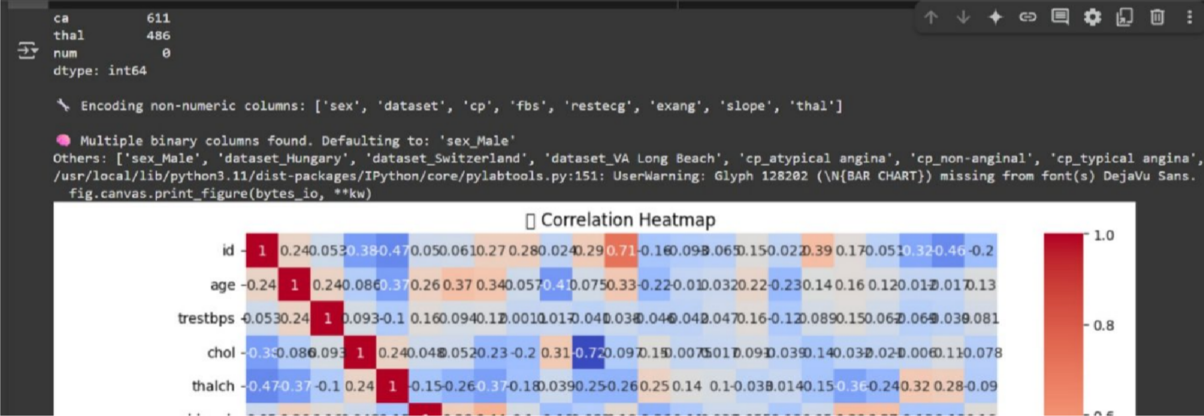
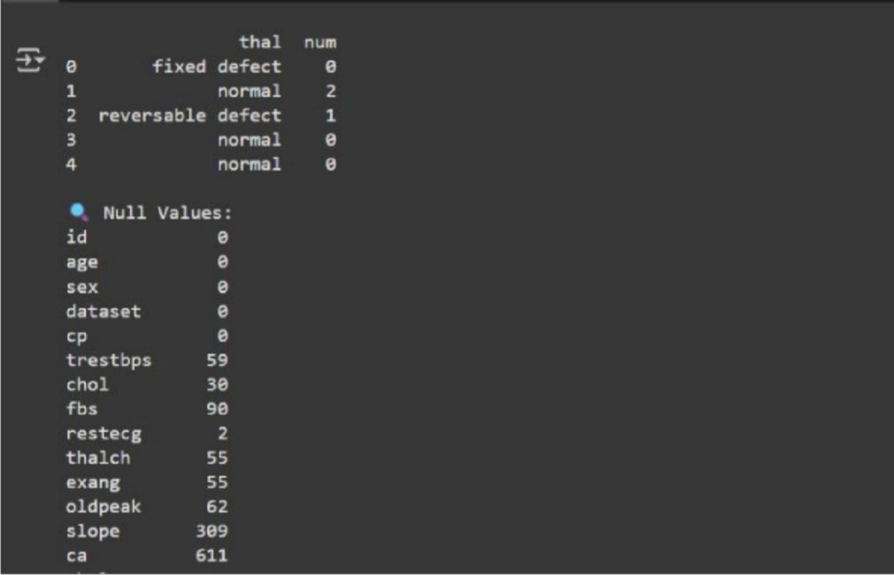

Slide 12
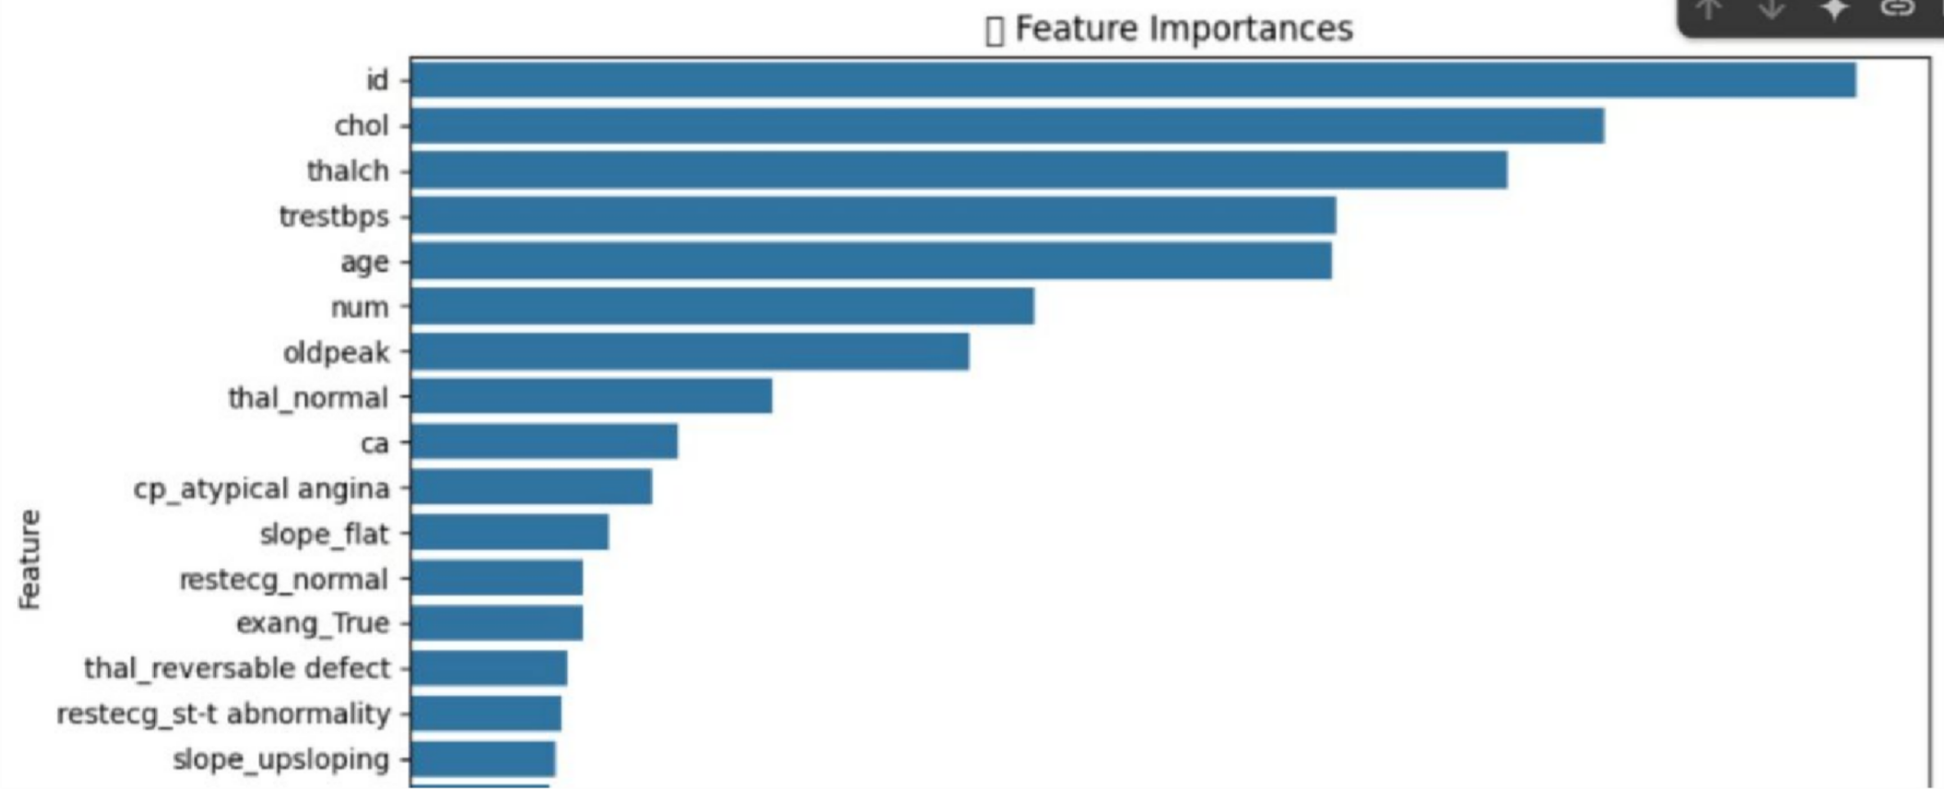
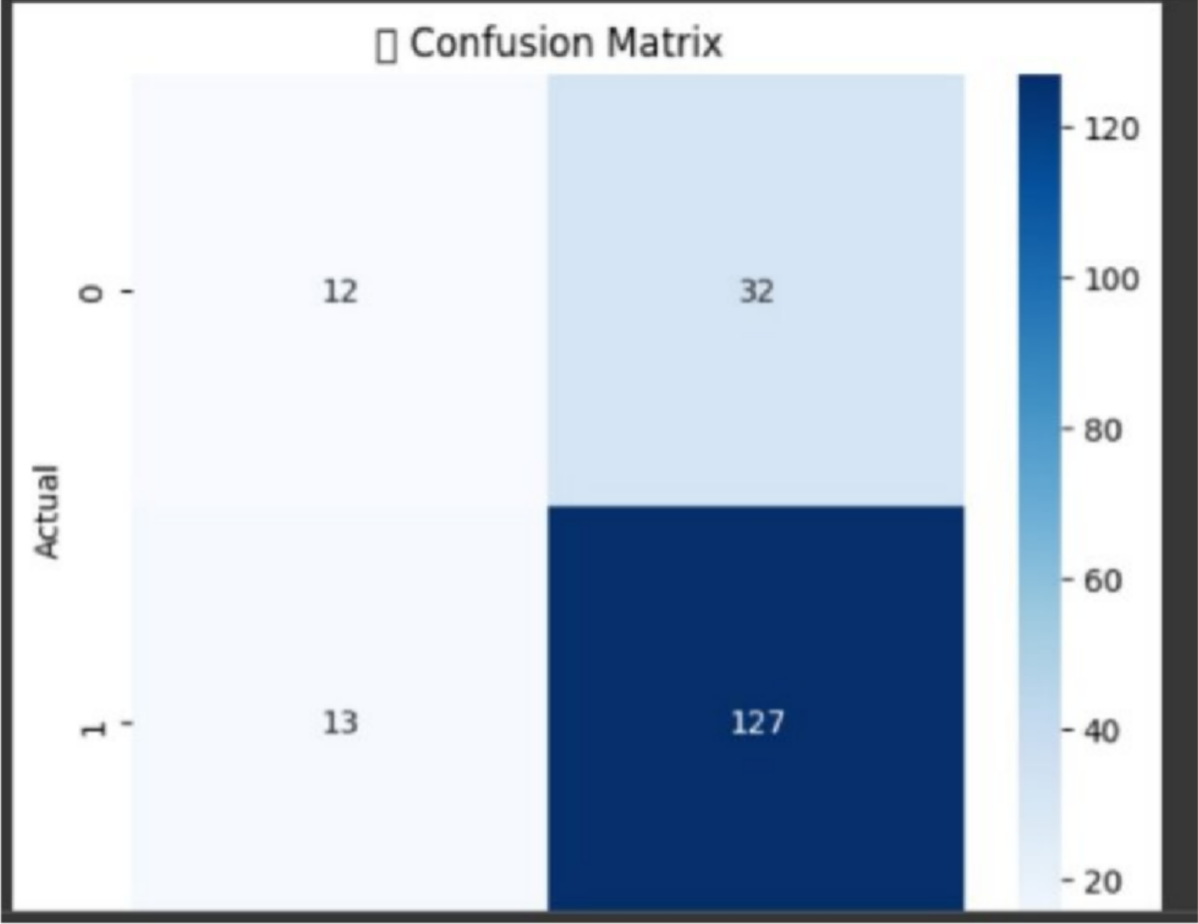

Slide 13
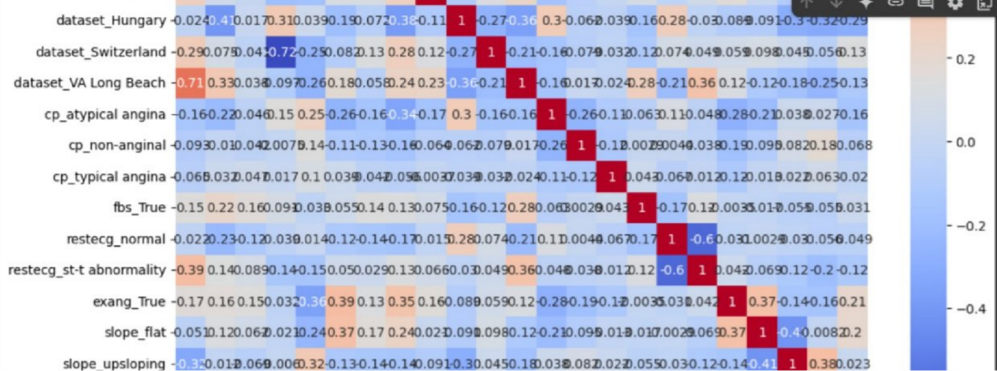
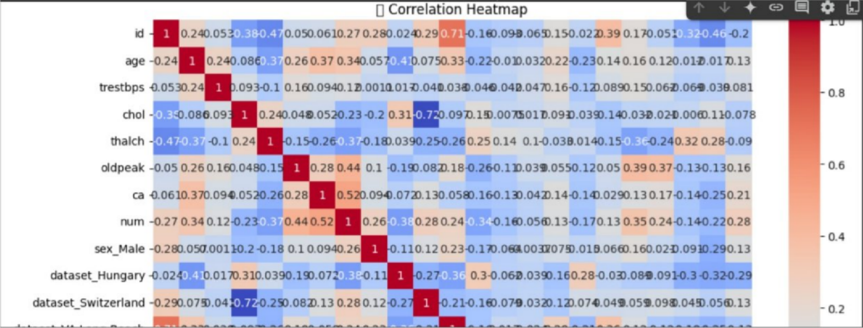

Slide 14

References/Credits
UCI Machine Learning Repository: https://archive.ics.uci.edu/ml/datasets/heart+Disease
Scikit-learn Documentation: https://scikit-learn.org
Kaggle Heart Disease Datasets

Slide 15


Thank You

